Slide 1
Subscriptions

Slide 2
Subscriptions
Allow subscribing to events in the GraphQL Server
When an event is triggered the subscription gets a notification
Usually used in conjunction with Mutations
Rarely used

Slide 3
Subscriptions Syntax
There are three main parts in the subscription request:
Subscription Object Type
Subscription Name
Returned Data

Slide 4

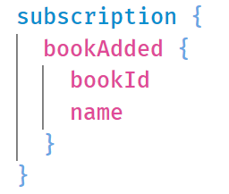
Subscriptions Syntax
There are three main parts in the mutation request:
subscription
object type
Subscription Name The name of the subscription we want to subscribe to
Defines that we’re running a subscription and not a query
Returned data
Reflect the new object that was added
The first step is to define and configure the subscription in
code

